Slide 1
Big data analytics
2.
2020

Slide 2
CLUSTERING ALGORITHMS FOR BIG DATA
Clustering algorithms have emerged as an alternative powerful meta-learning tool to accurately analyze the massive volume of data generated by modern applications
Their main goal is to categorize data into clusters such that objects are grouped in the same cluster when they are similar according to specific metrics
There is a vast body of knowledge in the area of clustering and there has been attempts to analyze and categorize them for a larger number of applications

Slide 3
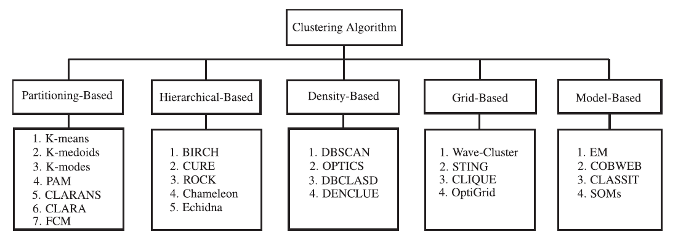
CLUSTERING ALGORITHM CATEGORIES

Slide 4
CLUSTERING ALGORITHM CATEGORIES
Partitioning-based:
In such algorithms, all clusters are determined promptly. Initial groups are specified and reallocated towards a union. In other words, the partitioning algorithms divide data objects into a number of partitions, where each partition represents a cluster. These clusters should full the following requirements:
(1) each group must contain at least one object
(2) each object must belong to exactly one group
In the K-means algorithm, for instance, a center is the average of all points and coordinates representing the arithmetic mean. In the K-medoids algorithm, objects which are near the center represent the clusters. There are many other partitioning algorithms such as K-modes, PAM, CLARA, CLARANS and FCM

Slide 5
CLUSTERING ALGORITHM CATEGORIES
Hierarchical-based:
Data are organized in a hierarchical manner depending on the medium of proximity. Proximities are obtained by the intermediate nodes. A dendrogram represents the datasets, where individual data is presented by leaf nodes. The initial cluster gradually divides into several clusters as the hierarchy continues. Hierarchical clustering methods can be agglomerative (bottom-up) or divisive (top-down).
An agglomerative clustering starts with one object for each cluster and recursively merges two or more of the most appropriate clusters.
A divisive clustering starts with the dataset as one cluster and recursively splits the most appropriate cluster. The process continues until a stopping criterion is reached (frequently, the requested number k of clusters).
The hierarchical method has a major drawback though, which relates to the fact that once a step (merge or split) is performed, this cannot be undone. BIRCH, CURE, ROCK and Chameleon are some of the well-known algorithms of this category.

Slide 6
CLUSTERING ALGORITHM CATEGORIES
Density-based:
Here, data objects are separated based on their regions of density, connectivity and boundary. They are closely related to point-nearest neighbours.
A cluster, defined as a connected dense component, grows in any direction that density leads to. Therefore, density-based algorithms are capable of discovering clusters of arbitrary shapes. Also, this provides a natural protection against outliers. Thus the overall density of a point is analyzed to determine the functions of datasets that influence a particular data point.
DBSCAN, OPTICS, DBCLASD and DENCLUE are algorithms that use such a method to filter out noise (outliers) and discover clusters of arbitrary shape.

Slide 7
CLUSTERING ALGORITHM CATEGORIES
Grid-based:
The space of the data objects is divided into grids. The main advantage of this approach is its fast processing time, because it goes through the dataset once to compute the statistical values for the grids. The accumulated grid-data make grid-based clustering techniques independent of the number of data objects that employ a uniform grid to collect regional statistical data, and then perform the clustering on the grid, instead of the database directly.
The performance of a grid-based method depends on the size of the grid, which is usually much less than the size of the database. However, for highly irregular data distributions, using a single uniform grid may not be sufficient to obtain the required clustering quality or fulfill the time requirement. Wave-Cluster and STING are typical examples of this category.

Slide 8
CLUSTERING ALGORITHM CATEGORIES
Model-based:
Such a method optimizes the fit between the given data and some (predefined) mathematical model. It is based on the assumption that the data is generated by a mixture of underlying probability distributions.
It leads to a way of automatically determining the number of clusters based on standard statistics, taking noise (outliers) into account and thus yielding a robust clustering method.
There are two major approaches that are based on the model-based method: statistical and neural network approaches.

Slide 9
CRITERION TO BENCHMARK CLUSTERING METHODS
When evaluating clustering methods for big data, specific criteria need to be used to evaluate the relative strengths and weaknesses of every algorithm with respect to the three-dimensional properties of big data, including Volume, Velocity, and Variety.
Volume refers to the ability of a clustering algorithm to deal with a large amount of data. To guide the selection of a suitable clustering algorithm with respect to the Volume property, the following criteria are considered: (i) size of the dataset, (ii) handling high dimensionality and (iii) handling outliers/ noisy data.
Variety refers to the ability of a clustering algorithm to handle different types of data (numerical, categorical and hierarchical). To guide the selection of a suitable clustering algorithm with respect to the Variety property, the following criteria are considered: (i) type of dataset and (ii) clusters shape.
Velocity refers to the speed of a clustering algorithm on big data. To guide the selection of a suitable clustering algorithm with respect to the Velocity property, the following criteria are considered: (i) complexity of algorithm and (ii) the run time performance.

Slide 10
CRITERION TO BENCHMARK CLUSTERING METHODS
Clustering algorithms evaluation criterions and Big Data properties:
1. Type Of Dataset: Most of the traditional clustering algorithms are designed to focus either on numeric data or on categorical data. The collected data in the real world often contain both numeric and categorical attributes. It is difcult for applying traditional clustering algorithm directly into these kinds of data. Clustering algorithms work effectively either on purely numeric data or on purely categorical data; most of them perform poorly on mixed categorical and numerical data types.
2. Size Of Dataset: The size of the dataset has a major effect on the clustering quality. Some clustering methods are more efcient clustering methods than others when the data size is small, and vice versa.
3. Input Parameter: A desirable feature for ``practical'' clustering is the one that has fewer parameters, since a large number of parameters may affect cluster quality because they will depend on the values of the parameters.

Slide 11
CRITERION TO BENCHMARK CLUSTERING METHODS
Clustering algorithms evaluation criterions and Big Data properties:
4. Handling Outliers/Noisy Data: A successful algorithm will often be able to handle outlier/noisy data because of the fact that the data in most of the real applications are not pure. Also, noise makes it dificult for an algorithm to cluster an object into a suitable cluster. This therefore affects the results provided by the algorithm.
5. Time Complexity: Most of the clustering methods must be used several times to improve the clustering quality. Therefore if the process takes too long, then it can become impractical for applications that handle big data.
6. Stability: One of the important features for any clustering algorithm is the ability to generate the same partition of the data irrespective of the order in which the patterns are presented to the algorithm.

